Slide 1
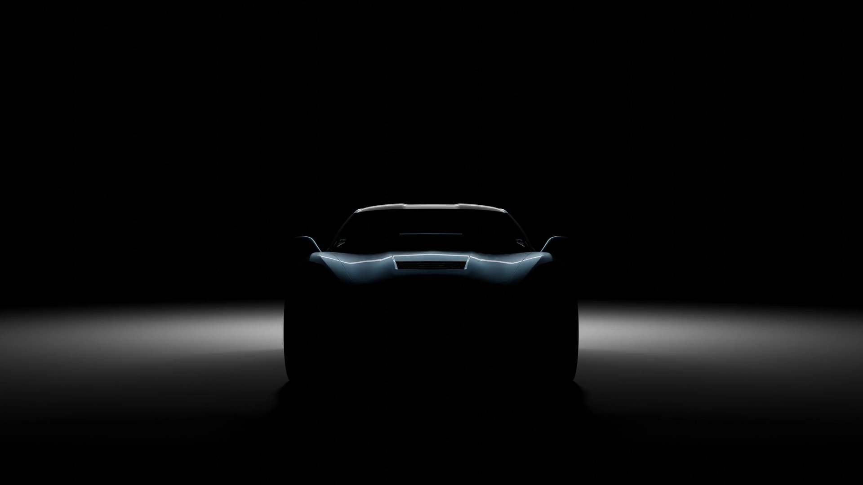
開車故事

Slide 2
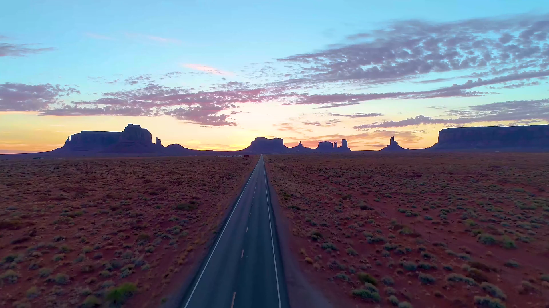
1.目標
Notes:
https://pixabay.com/videos/highway-road-car-transportation-70856/

Slide 3

2.阻礙
Notes:
https://pixabay.com/videos/emoji-icon-symbol-internet-sign-156364/

Slide 4

3.努力
Notes:
https://pixabay.com/videos/clock-time-gear-countdown-drive-7417/

Slide 5
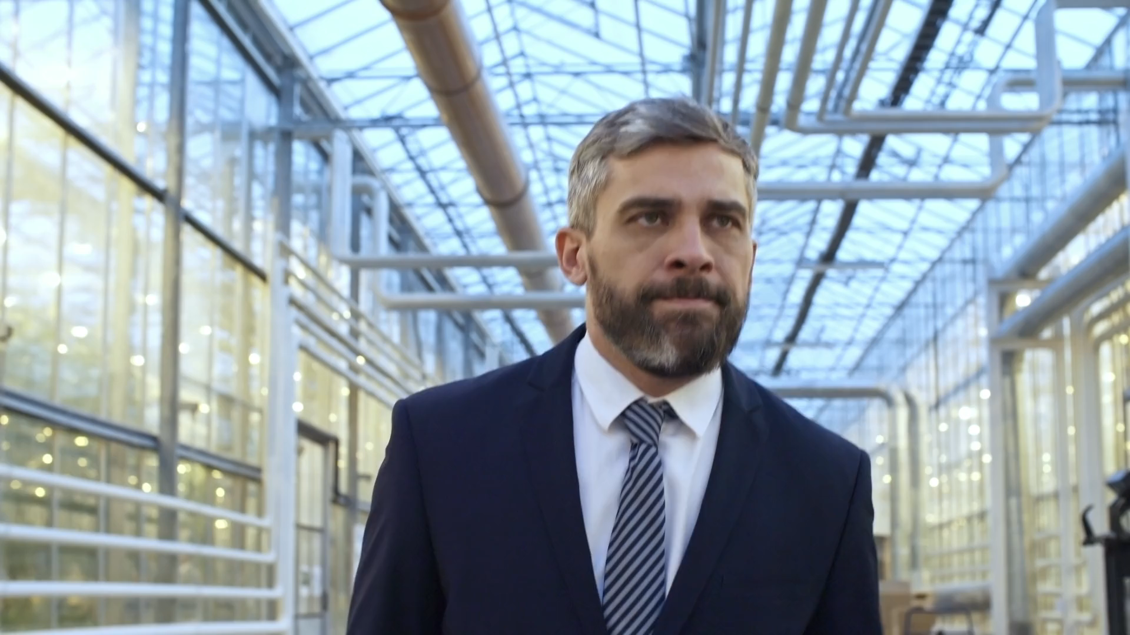
4.結果
Notes:
https://pixabay.com/videos/man-walking-suit-business-office-199623/

Slide 6
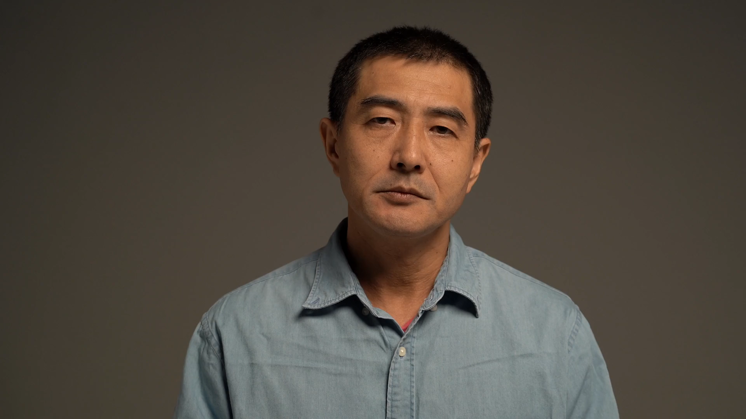
5.意外
Notes:
https://pixabay.com/videos/man-surprise-thinking-idea-122389/

Slide 7
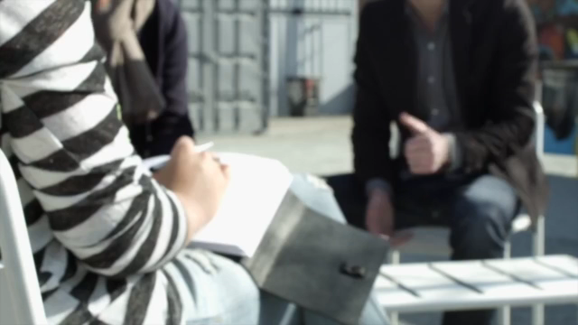
6.轉彎
Notes:
https://pixabay.com/videos/talk-discussion-meeting-team-group-1112/

Slide 8
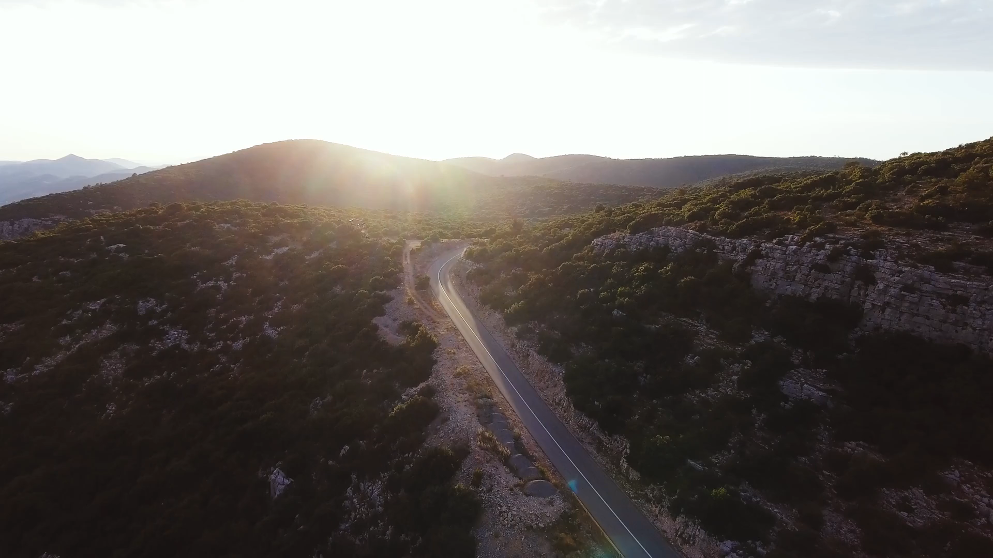
7.結局
Notes:
https://pixabay.com/videos/car-driving-sunset-sunlight-lens-11490/

